Slide 1
Bonding in transition Metal Complexes
For many decades, chemists and physicists struggled with possible explanations to account for the large number of transition metal compounds.
Such explanations had to account for the variety of colors, the wide range of stereochemistries, and the magnetic properties which leads to the development of different theories.
There are four theories of metal to ligand bonding in complexes.
1. Valence Bond Approach/Theory
2. Crystal field Theory
3. Ligand field Theory
4. Molecular Orbital Theory

Slide 2
Valence Bond Approach
This approach of coordination compounds was mainly developed by Linus Pauling
Pauling assumes that atomic orbitals mix to form hybrid orbitals, such as sp, sp², sp³, dsp³, and d²sp³ orbitals to form a complex
According to this approach, the formation of a complex is considered to be a reaction:
between a Lewis base (ligand) and a Lewis acid (metal or metal ion)
VB theory treats metal to ligand (donor group) bonds as coordinate covalent bonds:
formed when a filled orbital of a donor atom overlaps with an empty hybrid orbital on the central metal atom
The metal atom or ion under the influence of ligands can use
(n-1)d, ns, np or ns, np, nd orbital for hybridization to yield a set of equivalent orbitals
Number and type of M-L hybrid orbitals determines geometry of the complex

Slide 3
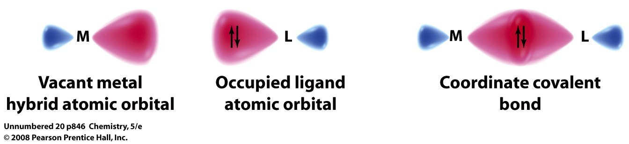
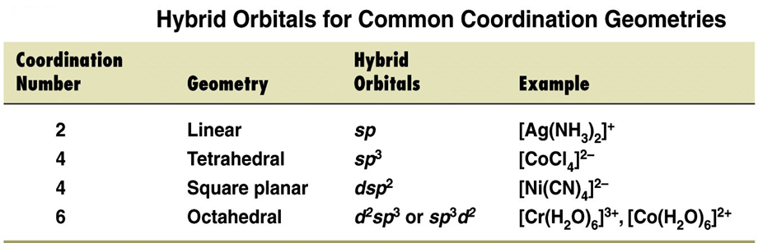
How do we view this and do we really need to ?
The theory proposes that the number of metal-ion hybrid orbitals occupied by donor atom lone pairs determine the geometry of the complexes

Slide 4
2-Coordinate Compounds:
Linear sp hybridized transition metal complexes:
Consider [Ag(NH₃)₂]⁺, Ag° = 5s¹ 4d¹⁰, Ag⁺ = 5s⁰ 4d¹⁰
Consider [Cu(CN)₂]⁻, Cu° = 4s¹ 3d¹⁰, Cu⁺¹ = 4s⁰ 3d¹⁰
4-Coordinate Compounds: (Tetrahedral Complexes)
Consider [ZnCl₄]⁻², Zn° = 4s² 3d¹⁰, Zn⁺² = 4s⁰ 3d¹⁰

Slide 5
Consider [Cd(NH₃)₄]⁺², Cd° = 5s² 4d¹⁰, Cd⁺² = 5s⁰ 4d¹⁰
Note that all 4-coordinate complexes of s⁰ d¹⁰ ion are sp³ hybridized and tetrahedral, e.g.,
4-coordinate complexes of Group 2B M⁺² ions: Zn⁺², Cd⁺², Hg⁺²
4-coordinate complexes of Group 1B M⁺¹ ions: Cu⁺¹, Ag⁺¹, Au⁺¹
In four coordinate complexes of s⁰d⁸ ions (Ni⁺², Pd⁺², Pt⁺²), two molecular geometries are encountered,
tetrahedral (sp³-with weak field ligands-high spin) and
square planar (dsp²-with strong field ligands-low spin)

Slide 6
4- Coordinate Compounds: (Square Planar Complexes)
When very strong ligands are present, four-coordinated d⁸ metal ions usually form square planar complexes (rather than tetrahedral)
Eg., [Ni(CN)₄]⁻², Ni° = 4s² 3d⁸, Ni⁺² = 4s⁰ 3d⁸
6-Coordinate Complexes (Octahedral)
Six ligand donor atoms in an octahedral complex are located at the corners of an octahedron.
Valence bond postulates that the orbitals best shaped and best oriented to receive electron pairs from these directions are
the d_{x2-y2} and d_{z2} orbitals (directed on the x, y, and z-axes)
Inner shell hybridization

Slide 7
Consider [Fe(CN)₆]⁻³, Fe° = 4s² 3d⁶, Fe⁺³= 4s⁰ 3d⁵
Consider [Fe(H₂O)₆]⁺³,Fe°= 4s² 3d⁶, Fe⁺³= 4s⁰ 3d⁵
Inner shell hybridization
Outer shell hybridization

Slide 8
Deficiencies of VBT approach
It does not give quantitative interpretation of magnetic data
It does not explain the colour exhibited by coordination compounds
It does not give a quantitative interpretation of the thermodynamic or kinetic stabilities of coordination compounds
It does not make exact predictions regarding the tetrahedral and square planar structures of 4-coordinate complexes
It does not distinguish between weak and strong ligands

Slide 9
Study the following examples and note where inner and outer shell hybridization occur and why.

Slide 11
Crystal Field Theory
This is an electrostatic model and simply uses the ligand electrons to create an electric field around the metal centre.
The transition metal(central metal atom) is regarded as a positive ion and is surrounded by negative or neutral ligands which have a lone pair of electrons
According to CFT, the attraction between the central metal and ligands in complex is considered to be :
@ - purely electrostatic, i.e ion-ion attraction b/n +ve and -ve ions, Or
@ - ion-dipole attractions if the ligands are a neutral molecule
Assumptions of CFT:
Ligands are considered as point charges and there are no metal–ligand covalent interactions
There is no interaction between metal orbitals and ligand orbitals
The d orbitals on the metal atom loses their degeneracy by the ligands when a complex is formed which results in splitting of d orbitals.

Slide 12
It considers how ligands affect the electronic energy of the d orbitals.
It best explains the color and magnetism of complex ions.

Slide 13
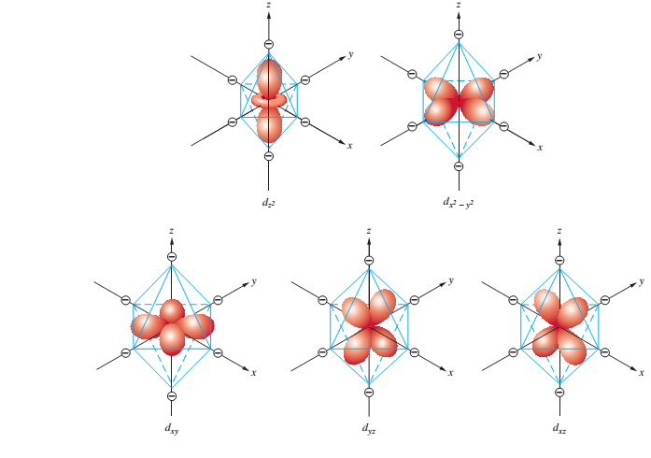

Slide 14
The crystal field splitting parameter (Δ)
The difference in energy between the two sets of d orbitals on a central metal ion that arises from the interaction of the orbitals with the electric field of the ligands
Different ligands produce different extents of splitting between the e_{g} and the t_{2g} levels.
This results different colors in the complex.

Slide 15
The crystal field splitting parameter (Δ)
The magnitude of ∆ depends on the following factors.
Nature of ligand: weak field ligands (cause only a small degree of splitting) and strong field ligands (cause a large splitting)
The common ligands are arranged in order of their strength and the series is called the spectrochemical series
I⁻ < Br⁻ < SCN⁻ ~Cl⁻ < F- < OH⁻ ~ ONO⁻ < C₂O₄²⁻ < H₂O < NCS⁻ < EDTA⁴⁻ < NH₃ ~ pyr ~ en < bipy < phen < CN⁻ ~ CO
The general guidelines for ordering the ligands is halides <oxygen donors <nitrogen donors <carbon donors
Charge on the metal atom: The magnitude of ∆ increases as the charge on central metal atom increases and in general M³⁺ complexes have double the value than that of M²⁺ complexes
Position of the metal in the transition series
The magnitude of ∆ increases on descending down the group of transition metals.
The number of the ligands:
The crystal field splitting is greater for a larger number of ligands.
For example, Δoct, the splitting for six ligands in an octahedral environment, is much greater than Δtet, the splitting for four ligands in a tetrahedral environment.
Depending upon the d electron configuration of the metal ion, and under specific environment around it, its complex acquires stability

Slide 16
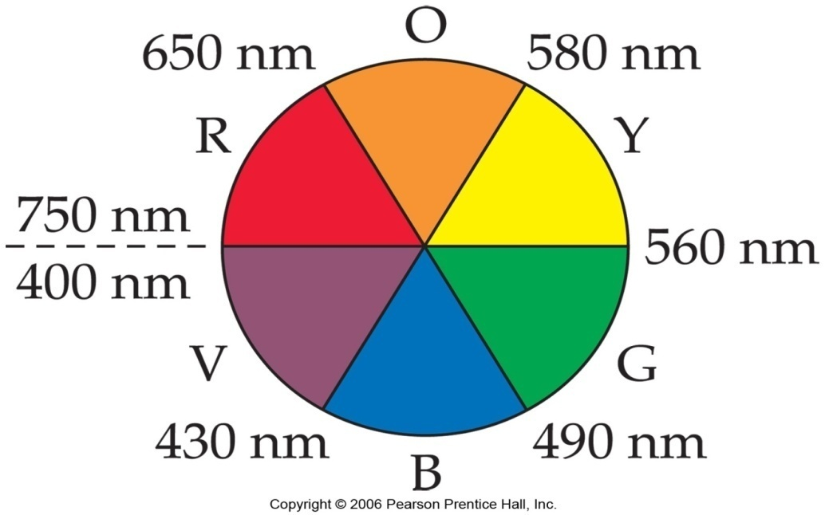
Spectrochemical Series
Spectrochemical series is an arrangement of ligands according to the relative magnitudes of the crystal field splittings they induce in the d orbitals of a metal ion.
The splitting due to the nature of the ligand can be observed and measured using a spectrophotometer.
Smaller values of ∆_{o} result in colors in the green range. Larger gaps shift the color to yellow.
Based on measurements for a given metal ion, the following series has been developed:
I⁻<Br⁻<S²⁻<Cl⁻<NO₃⁻<N₃⁻<F⁻<OH⁻<C₂O₄²<H₂O<NCS<CH₃CN<pyridine<NH₃<en<bipy<phen<NO₂⁻<PPh₃<CN⁻<CO.
The spectrochemical series for metal ions is approximately:
Mn²⁺ < Ni²⁺ < Co²⁺ < Fe²⁺ < V²⁺ < Fe³⁺ < Co³⁺ < Mn⁴⁺ < Mo³⁺ < Rh³⁺ < Ru³⁺ < Pd⁴⁺ < Ir³⁺ < Pt⁴⁺

Slide 17
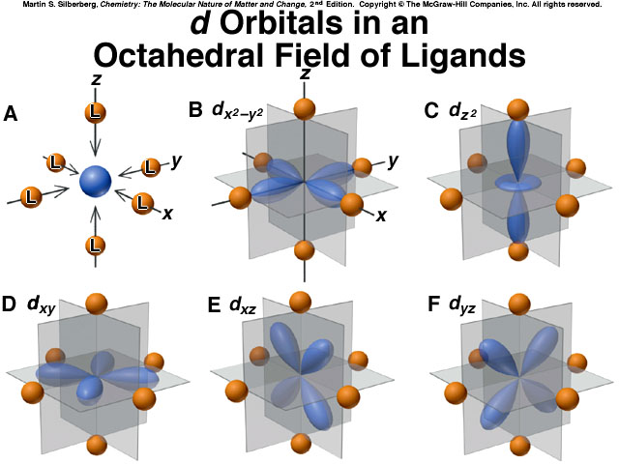
Octahedral Complexes
the metal is at the centre of the octahedron and ligands are at the six corners.
The x, y, z axes point to the corners of the octahedron.
The e_{g} orbitals (d_{x}²-_{y}² and d_{z}²) are directed along the axes and t_{2g} orbitals (d_{xy}, d_{yz}, d_{xz}) point in between the axes

Slide 18
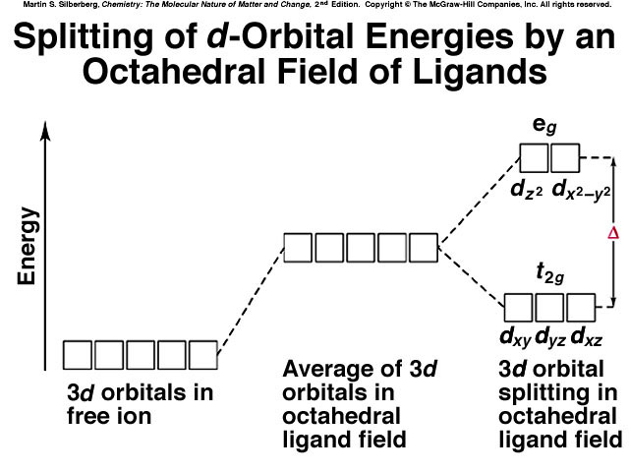

Slide 19
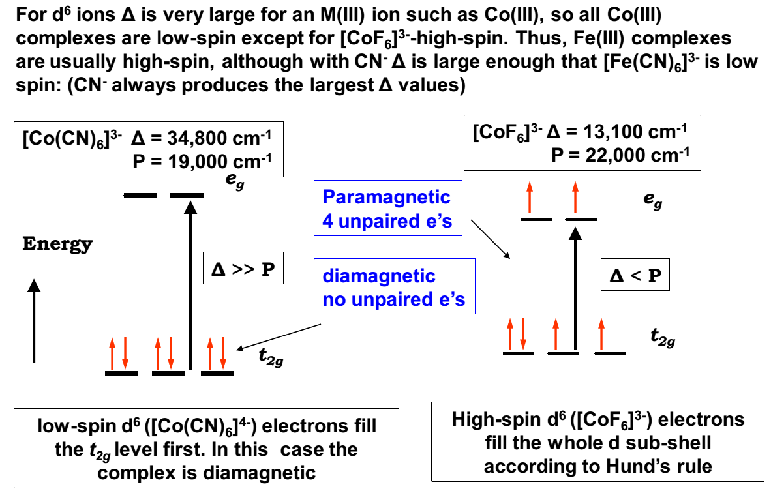
High Spin (Weak Field) and Low Spin (Strong Field) complexes
When metal ions that have between 4 and 7 electrons in the d orbitals form octahedral compounds,
two possible electron distributions can occur.
These are referred to as either weak field - strong field or high spin - low spin configurations. E.g.,

Slide 20
Crystal Field Stabilization Energy (CFSE)
When splitting of the d sub-shell occurs,
the occupation of the lower energy t_{2g} level by electrons causes a stabilization of the complex,
whereas occupation of the e_{g} level causes a rise in energy.
Calculations show that the t_{2g} level drops by 0.4Δ, whereas the e_{g} level is raised by 0.6Δ.
This means that the overall change in energy, the CFSE, will be given by:
where n(t_{2g}) and n(e_{g}) are the numbers of electrons in the t_{2g} and e_{g} levels respectively.
CFSE= {(3/5n_{eg}) – (2/5n_{t2g})} ∆₀ = Δ₀[0.6n(e_{g})-0.4n(t_{2g})]

Slide 21
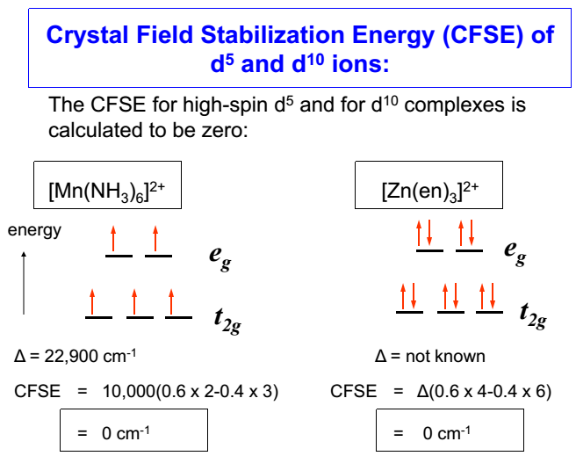

Slide 22
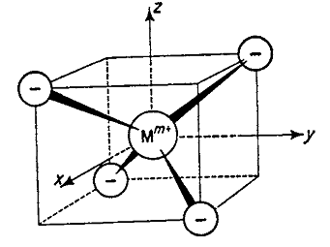
Tetrahedral Complexes
The metal atom is at the center of the regular tetrahedron (related to a cube) and Four of the eight corners of a cube are occupied by four ligands as shown below
In this case none of the d orbitals will point directly at the ligands
However, the orbitals that have lobes lying along the axes (d _{x}²₋ _{y} ² and d_{z}²) are directed toward a point that is midway along a diagonal of a face of the cube.
The orbitals that have lobes projecting between the axes (d_{xy}, d_{yz}, and d_{xz}) are directed toward the midpoint of an edge that is only l/2 from sites occupied by ligands.

Slide 23
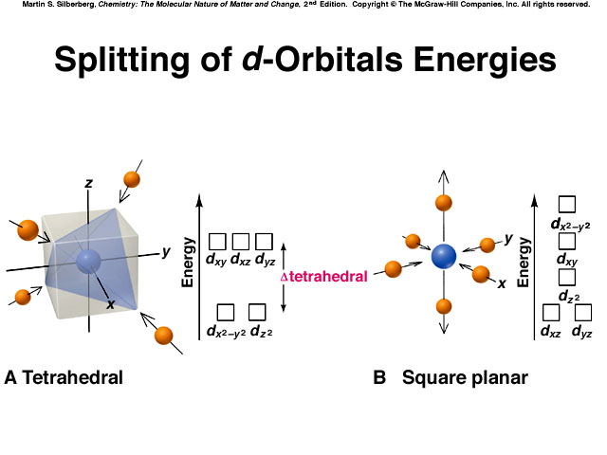
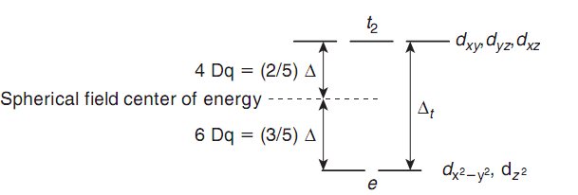
The result is that d_{xy}, d_{yz}, and d_{xz} orbitals are higher in energy than are d _{x}²₋ _{y} ² and d_{z}² orbitals because of the difference in how close they are to the ligands
The splitting pattern produced by an octahedral field is inverted in a tetrahedral field
Tetrahedral complexes are favored when
the ligands are large and bulky and could cause crowding in an octahedral complex
the ligands are weak field, so that the loss in CFSE is not that important
the central metal has a low oxidation state and as a result the magnitude of ∆t is small
the electronic configuration of the central metal is d⁰, d⁵or d¹⁰ as there is no CFSE in these cases or d¹ or d⁶ where the loss in CFSE is small

Slide 24

Square Planner Complexes
For central metal atom in a complex with d⁸ configuration,
six electrons will occupy t_{2g} orbitals and the rest two will go to the e_{g} orbitals irrespective of whether ligand is weak or strong field
In a complex with very strong field ligand, the single electron in dx²-y² orbital is repelled by four ligands while electron in dz² orbital is repelled by only two ligands
As a result the energy of d_{x}²_{-y}² orbital increases relative to the other orbital

Slide 25
Limitations of CFT
It considers only the metal ion d-orbitals and gives no consideration at all to other metal orbitals (such as s, p_{x},p_{y} and p_{z} orbitals)
It is unable account satisfactorily for the relative strengths of the ligands
According to this theory , the bond b/n the metal and the ligand are purely ionic
It gives no account on the partly covalent nature of the metal ligand bonds
It cannot account for π bonding in complexes

Slide 26
